Slide 2
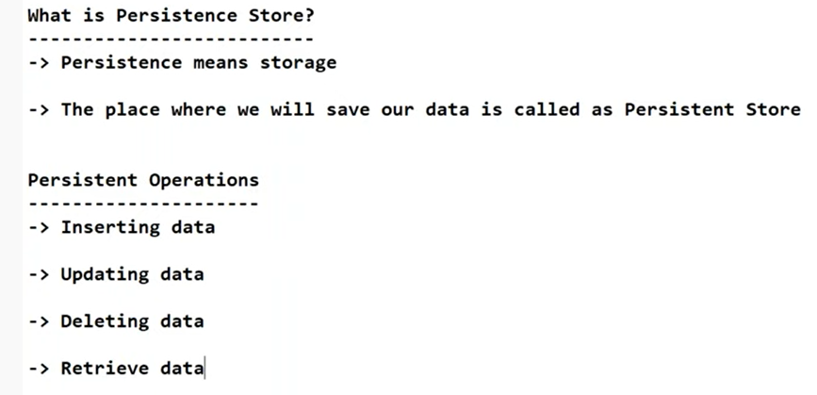

Slide 3
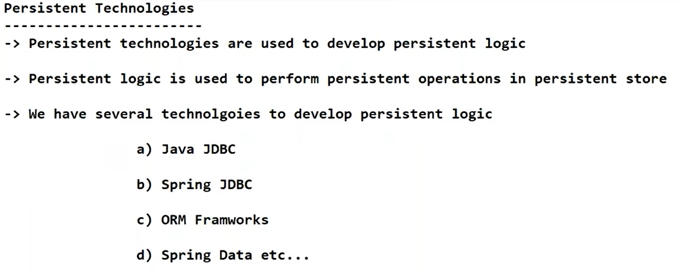
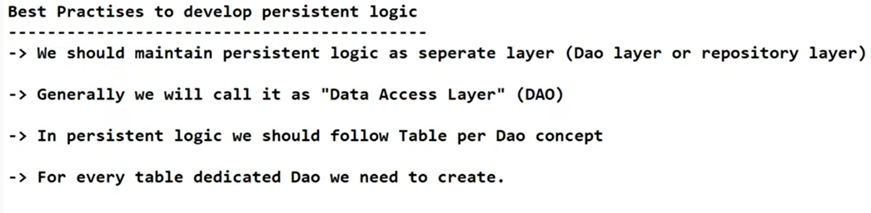

Slide 4
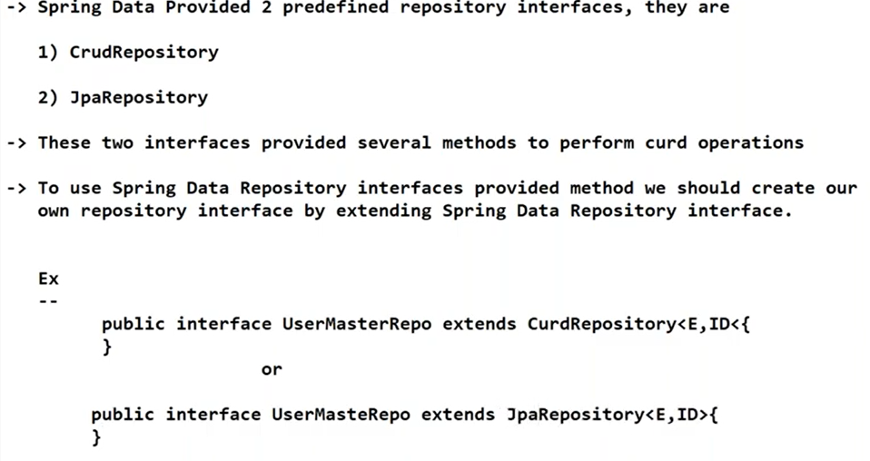

Slide 5
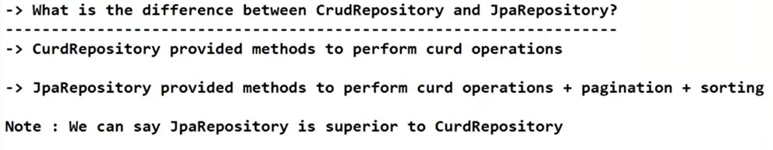
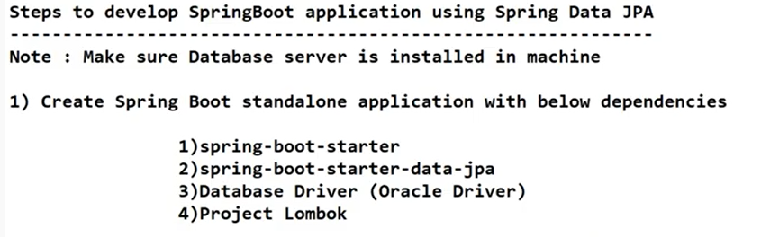

Slide 6
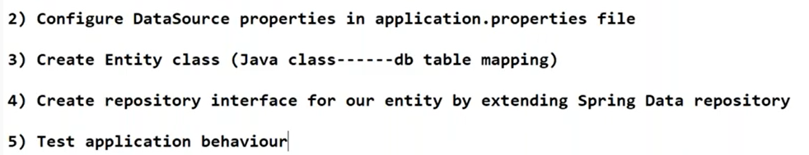
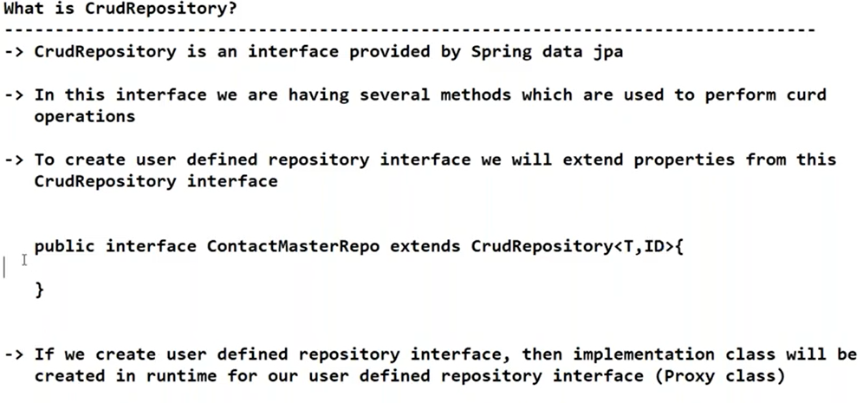

Slide 7
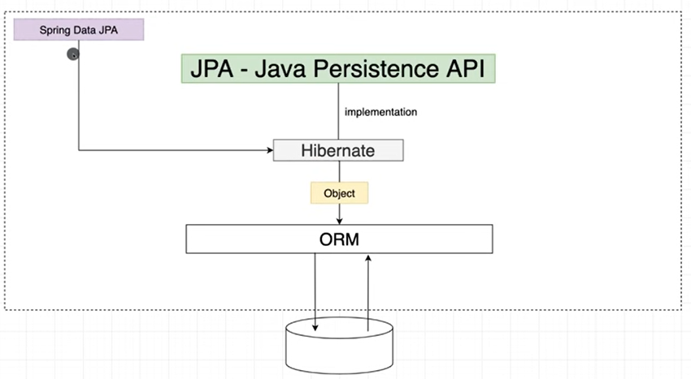

Slide 8
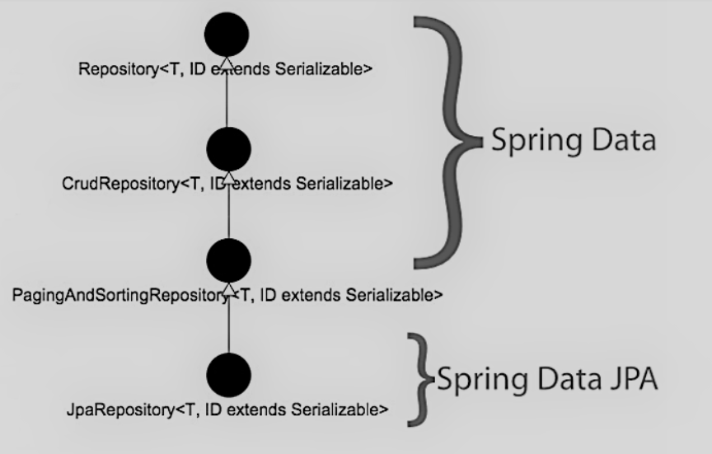

Slide 9
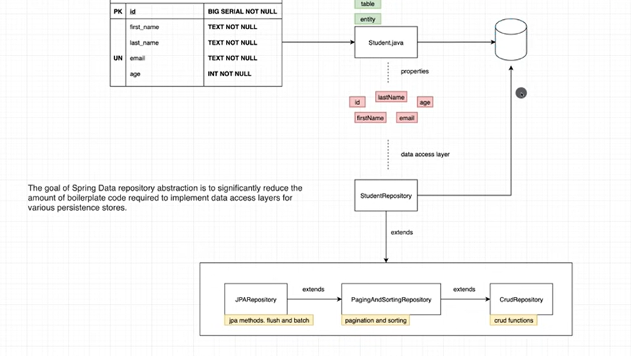

Slide 10
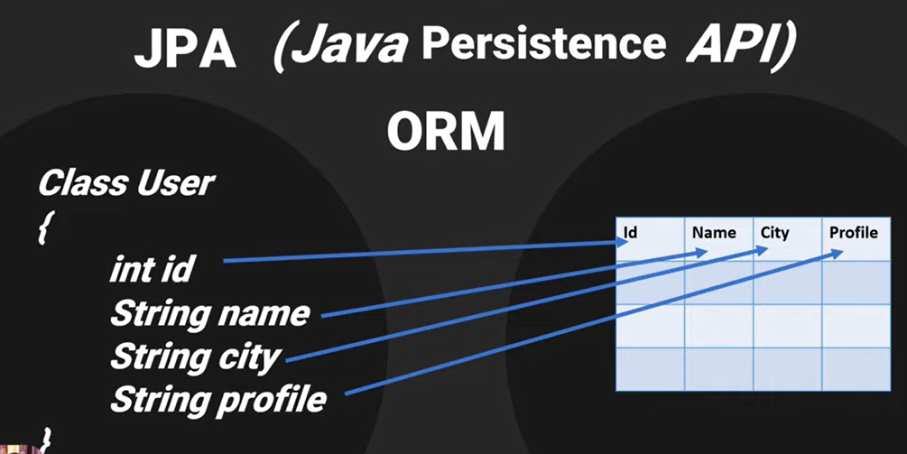

Slide 11
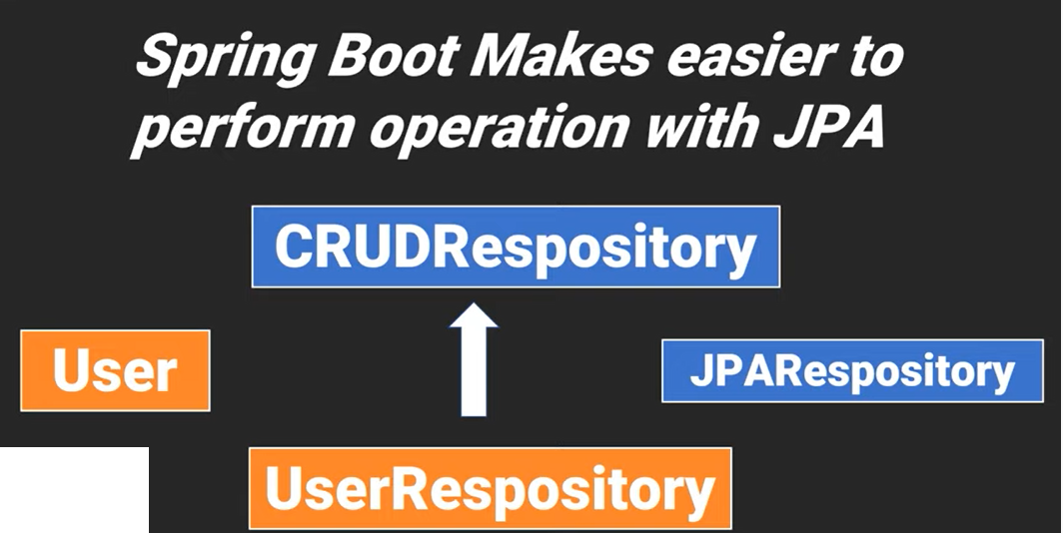

Slide 12
Modal layer:
Create a simple POJO(Plain old java class) with some JPA annotation.
@Entity: This annotation defines that a class can be mapped to a table
@Id: This annotation specifies the primary key of the entity.
@GeneratedValue: This annotation is used to specify the primary key generation strategy to use. i.e. Instructs database to generate a value for this field automatically. If the strategy is not specified by default AUTO will be used.

Slide 13
DAO(Data access object) layer:
@Repository: The @Repository annotation is a marker for any class that fulfills the role or stereotype of a repository (also known as Data Access Object or DAO).
JpaRepository<Employee, Long> JpaRepository is a JPA-specific extension of the Repository. It contains the full API of CrudRepository and PagingAndSortingRepository. So it contains API for basic CRUD operations and also API for pagination and sorting.

Slide 14
@Service: This annotation is used with classes that provide some business functionalities. Spring context will autodetect these classes when annotation-based configuration and classpath scanning is used.

Slide 15
Controller layer:
@RestController: This is a Spring annotation that is used to build REST API in a declarative way. RestController annotation is applied to a class to mark it as a request handler, and Spring will do the building and provide the RESTful web service at runtime.
@Autowired: This annotation can be used to autowire bean on the setter method just like @Required annotation, constructor, a property, or methods with arbitrary names and/or multiple arguments.
@PostMapping: This annotation maps HTTP POST requests onto specific handler methods. It is a composed annotation that acts as a shortcut for @RequestMapping(method = RequestMethod. POST)
@GetMapping: This annotation is a specialized version of @RequestMapping annotation that acts as a shortcut for @RequestMapping(method = RequestMethod. GET). The @GetMapping annotated methods in the @Controller annotated classes handle the HTTP GET requests matched with the given URI expression.
@DeleteMapping: This annotation maps HTTP DELETE requests onto specific handler methods. It is a composed annotation that acts as a shortcut for @RequestMapping(method = RequestMethod. DELETE)

